Slide 1
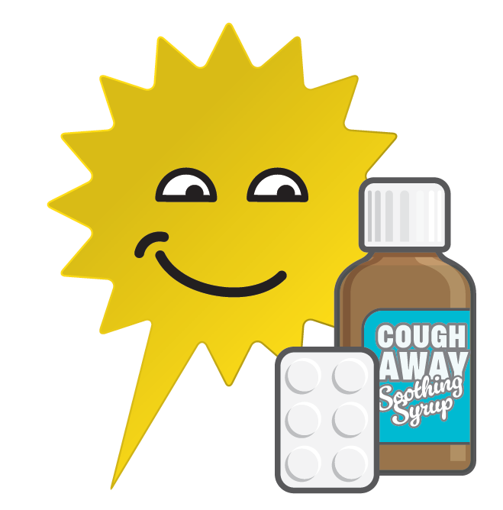
Are you ready for the festive bank holidays?
Some health services will be closed on Christmas and New Year bank holidays.
Make sure you’re ready and have all the medicines you might need.

Slide 2
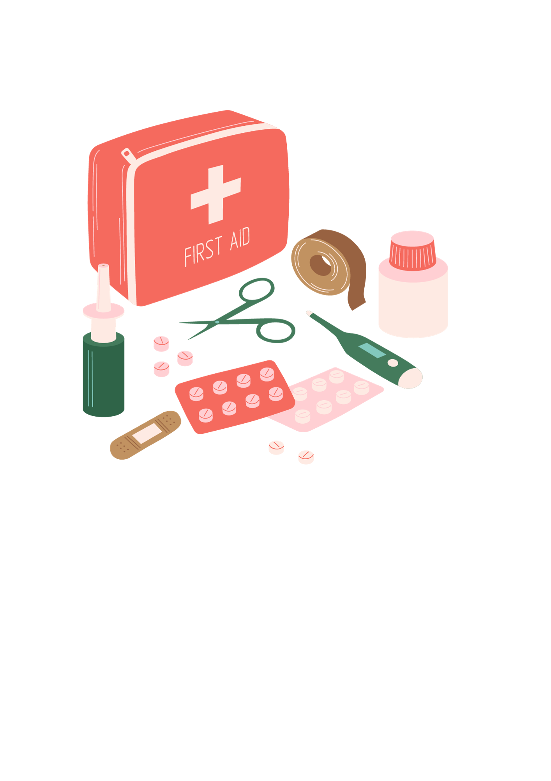
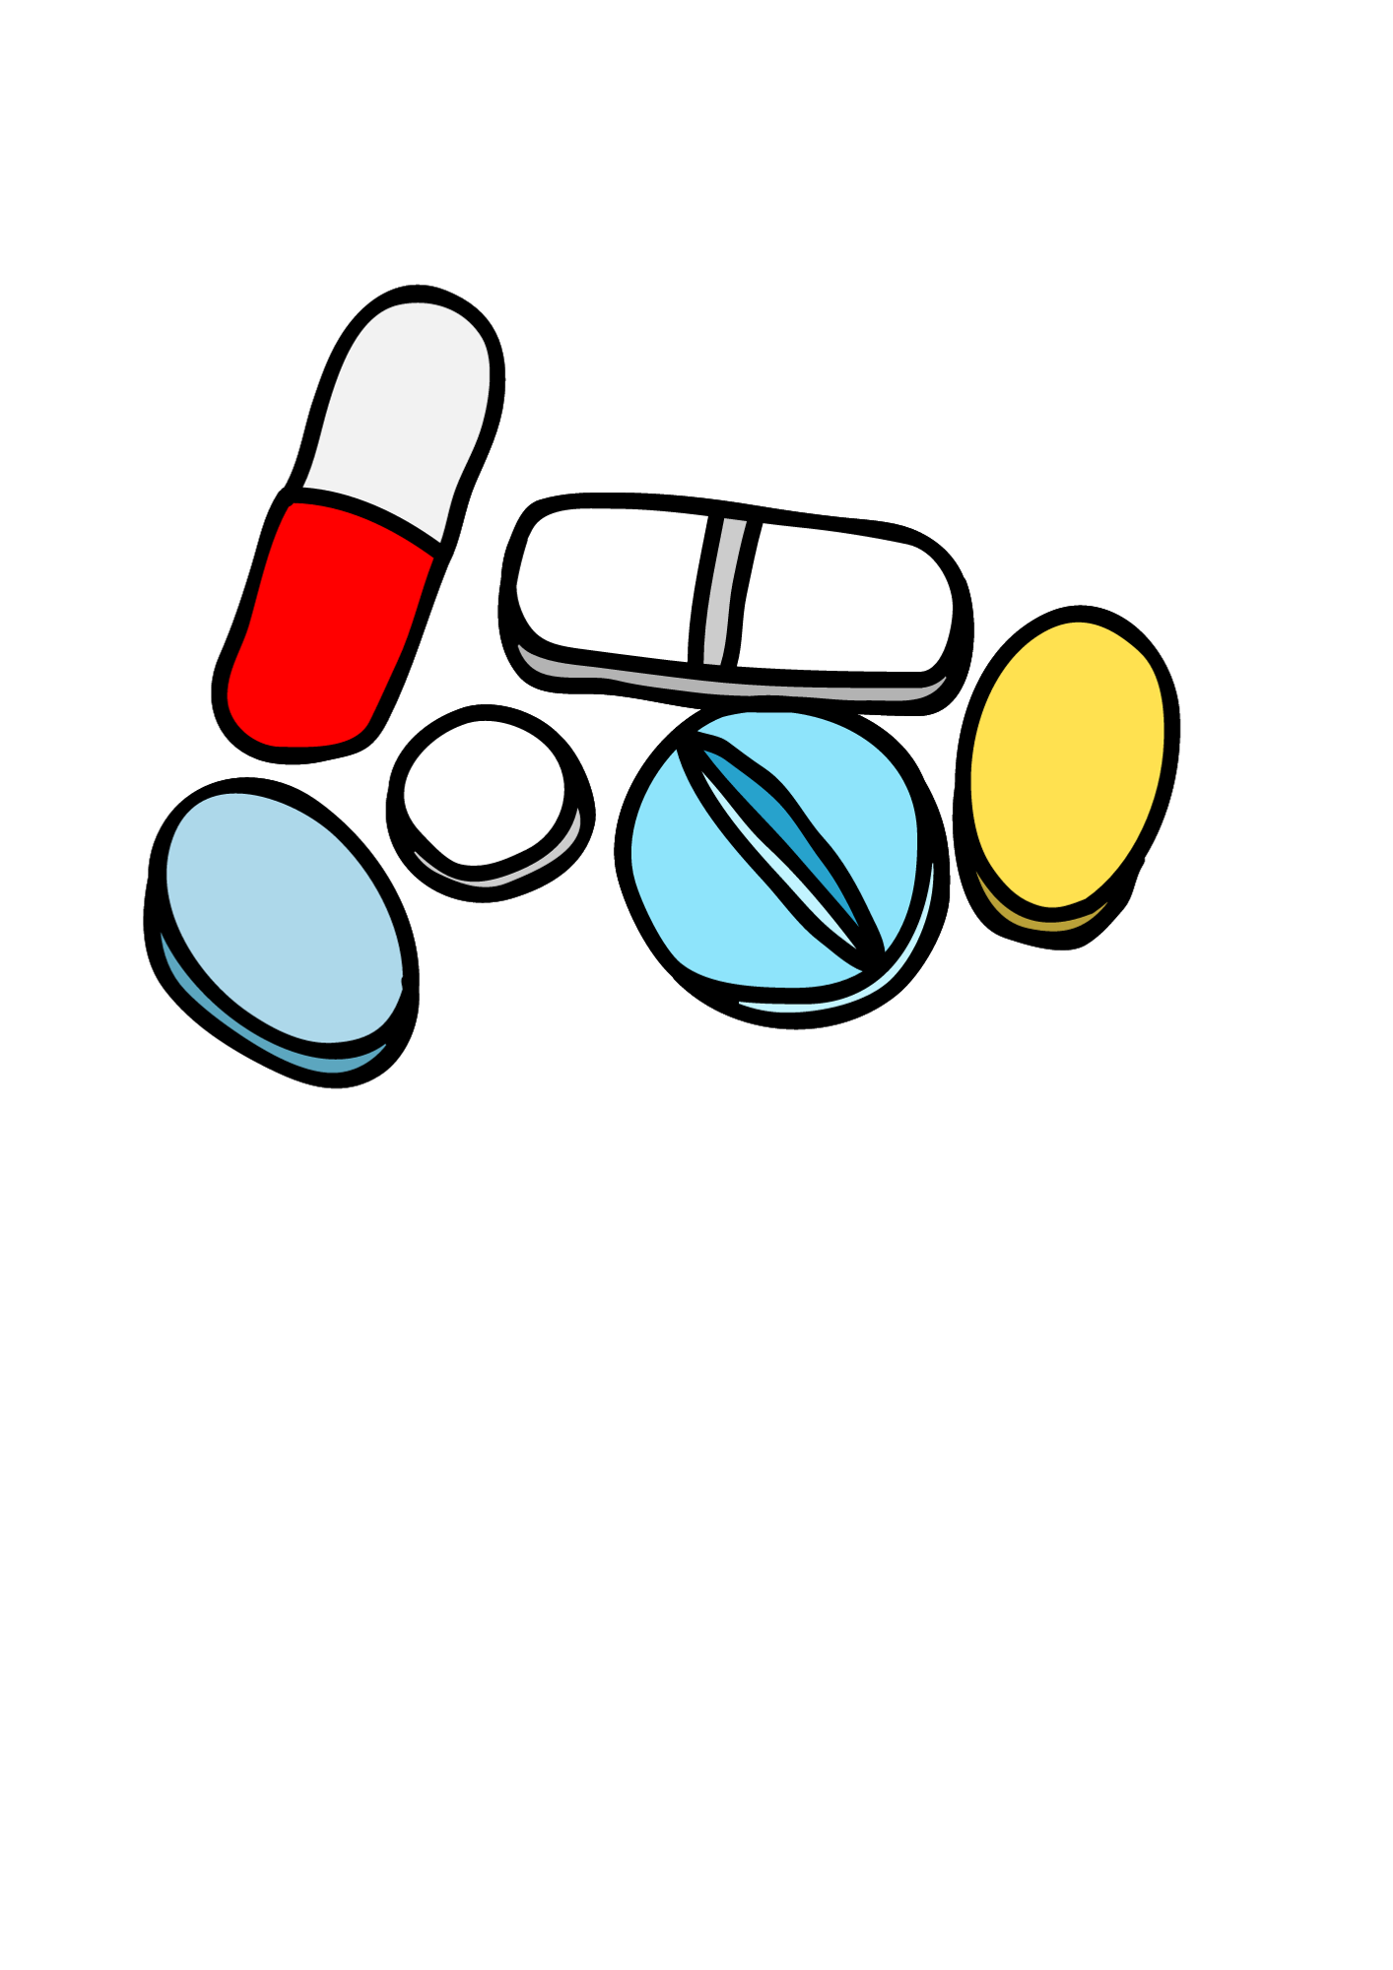
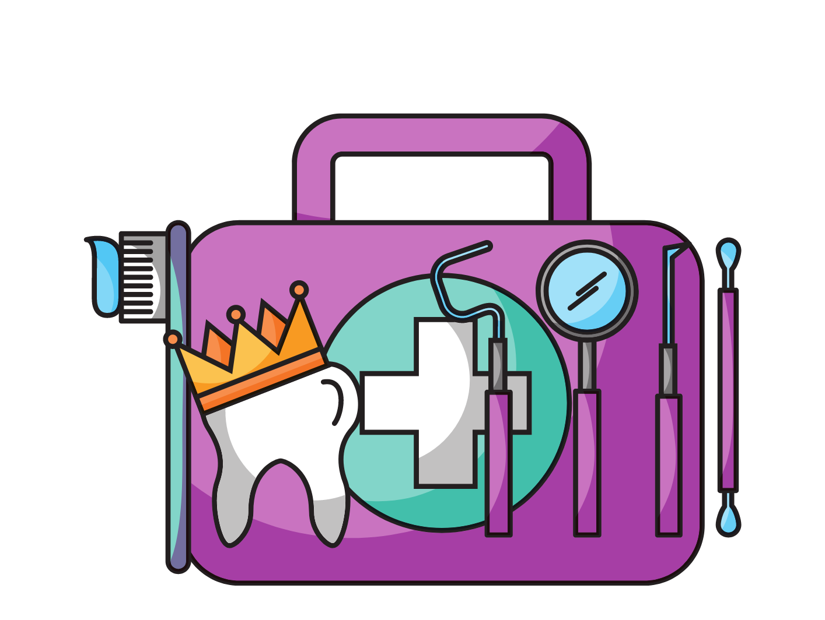
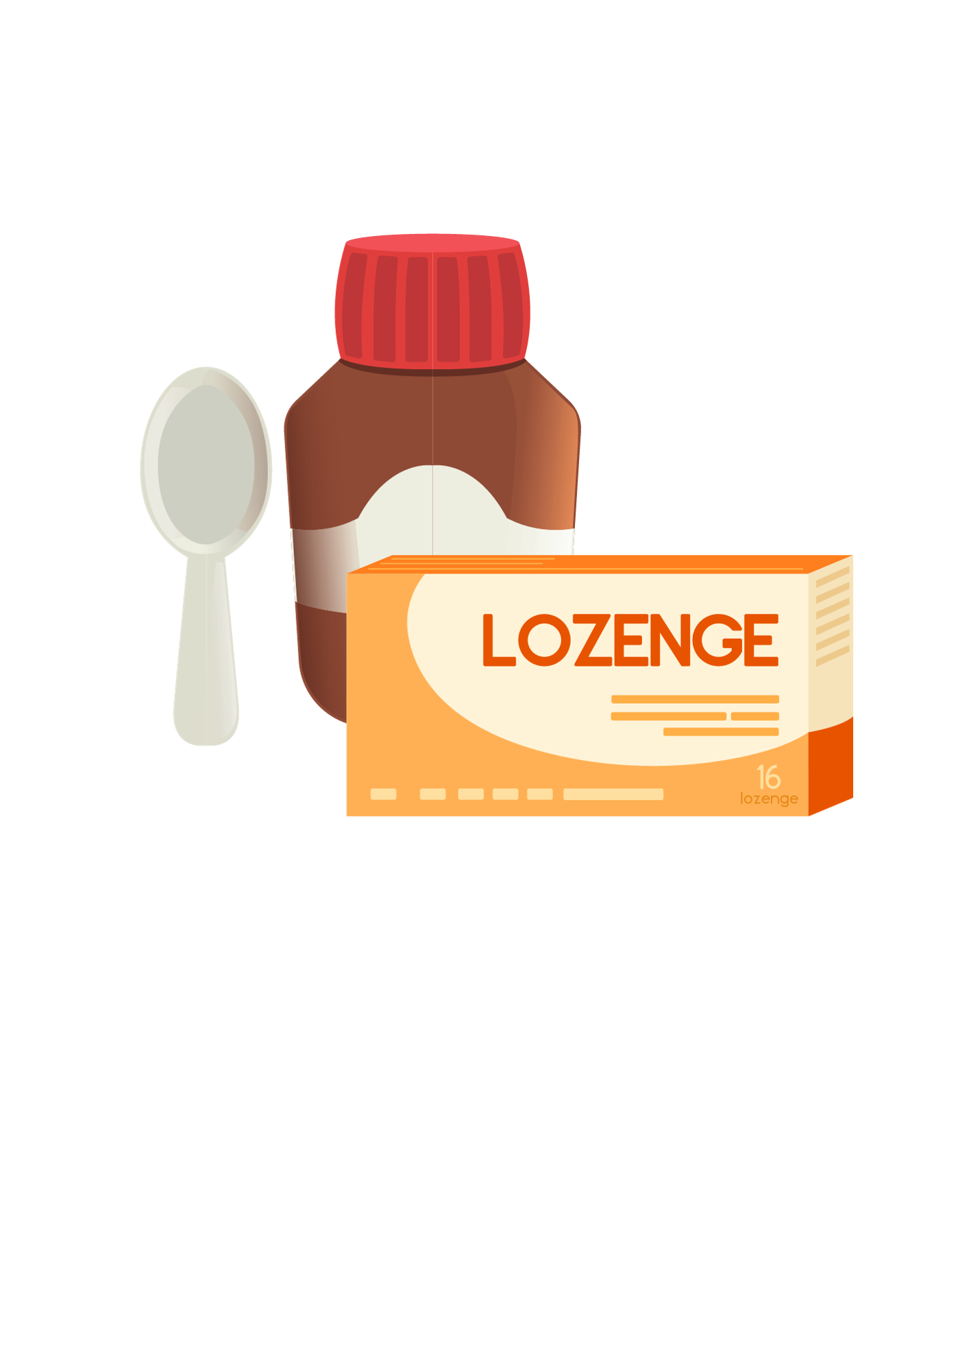
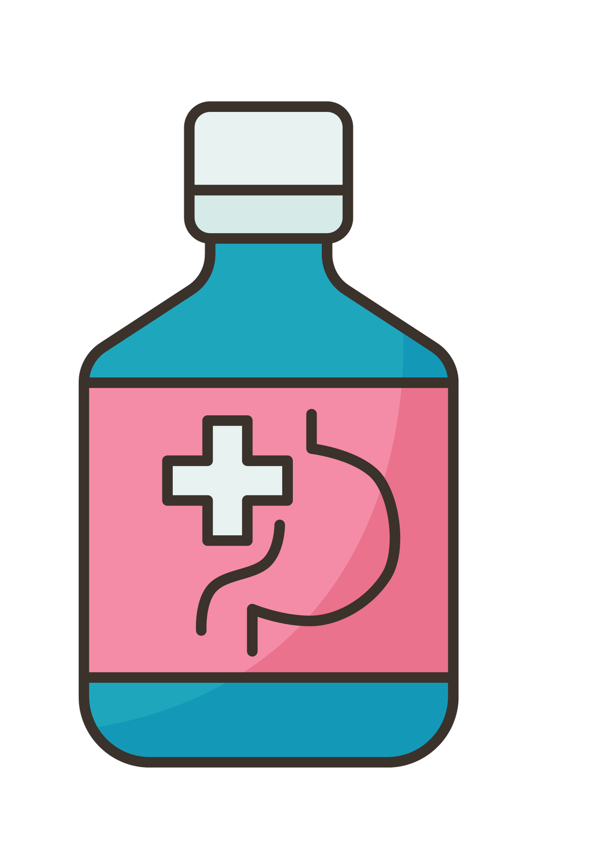
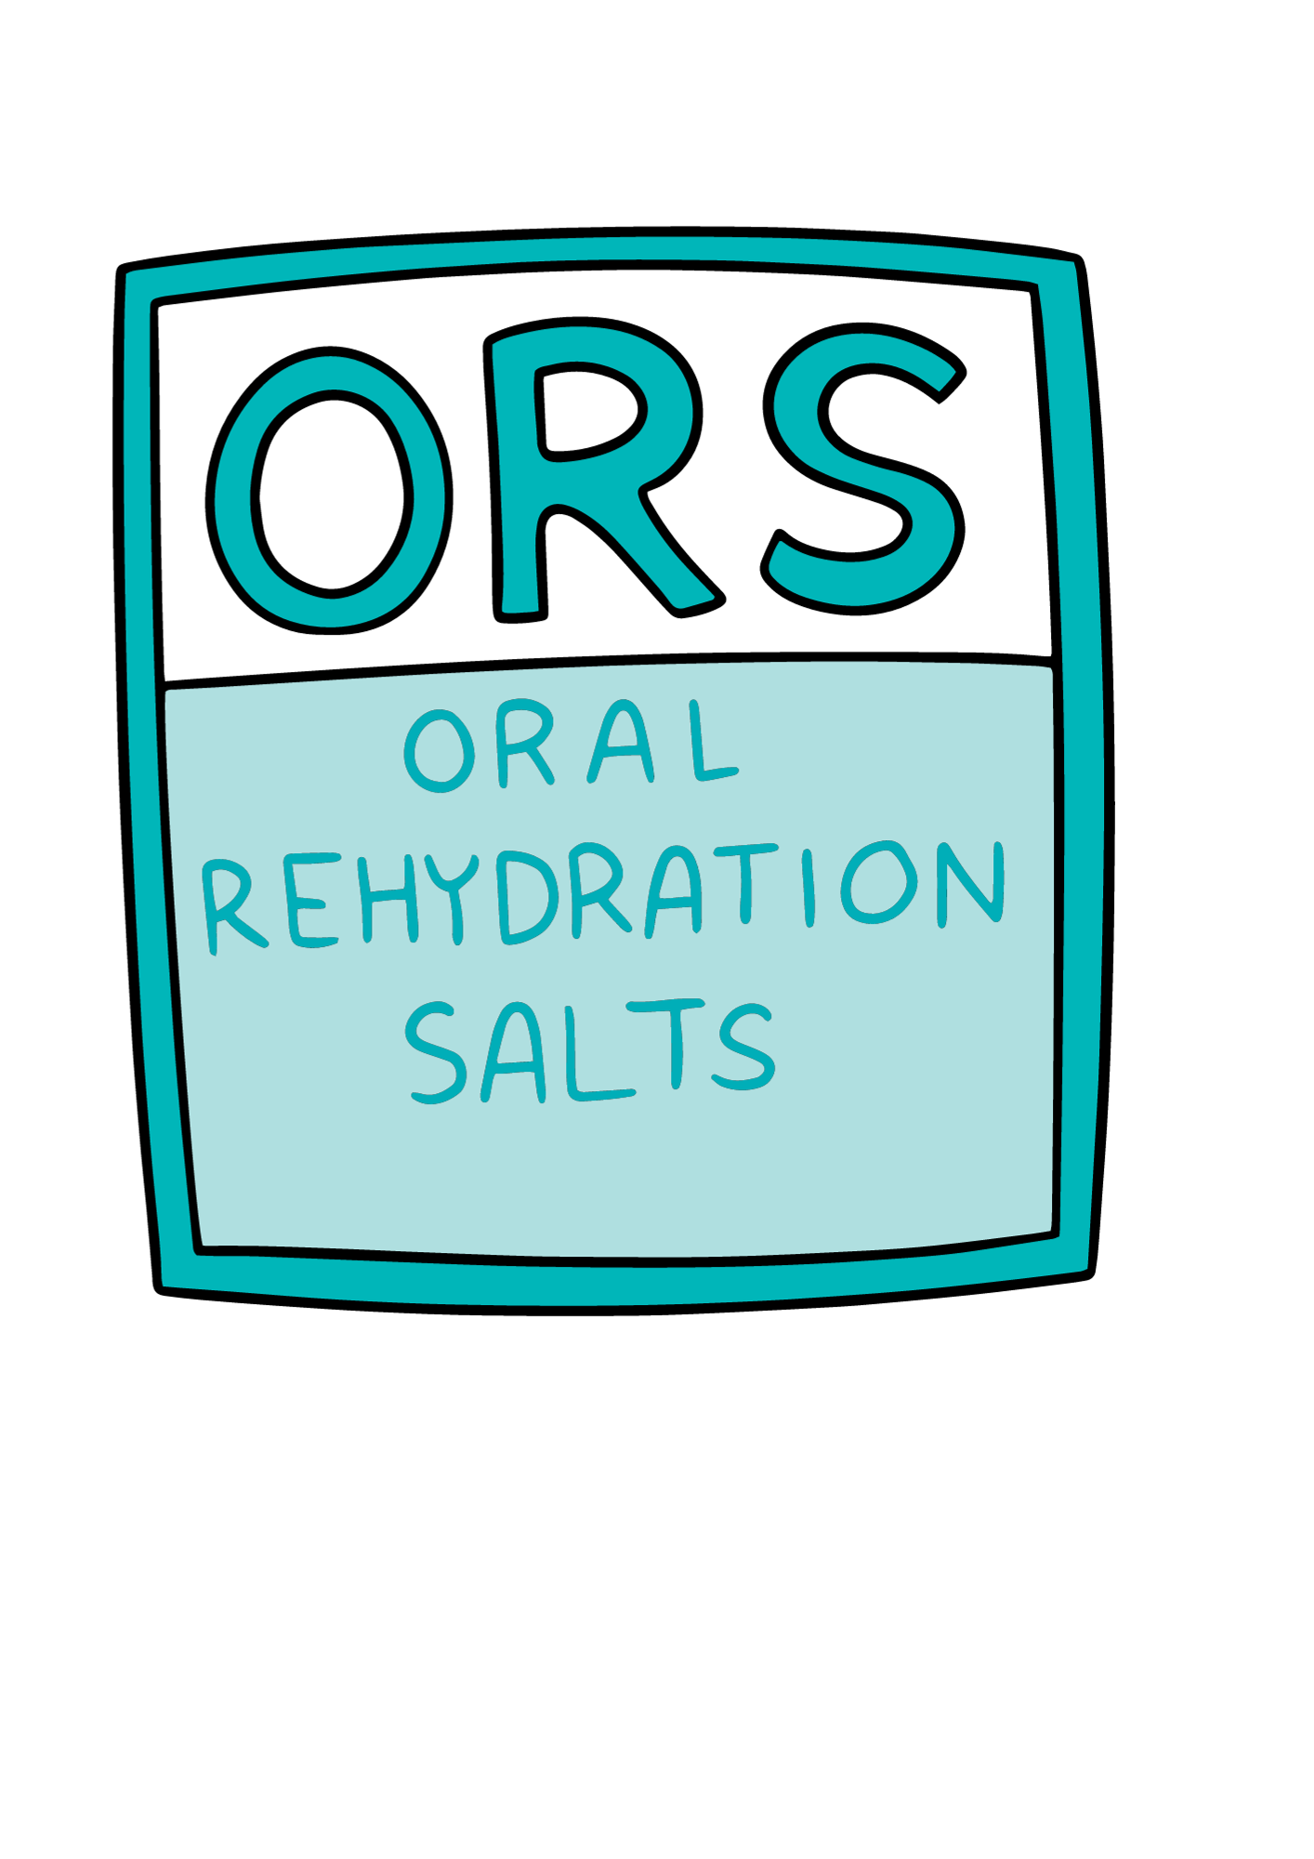
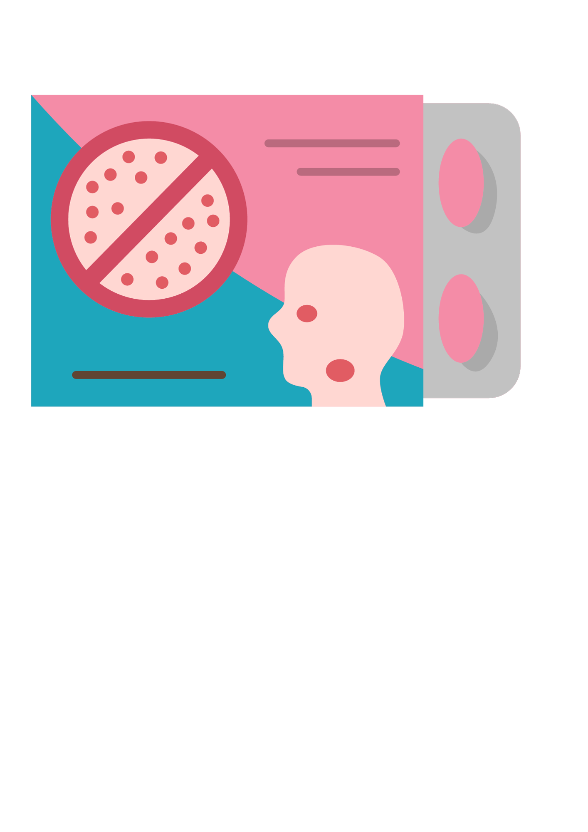
A properly stocked medicine cabinet can help you treat many common illnesses and ailments over the cold winter months.
Stock up yours now and replace any out-of-date items.
(These can all be bought cheaply from your supermarket or community pharmacy)
Rehydration salts
Cough and cold medicine
First Aid Kit
Prescription medicines (if you need them)
Emergency dental kit
Pain relief
Antihistamines
Indigestion tablets
Are you ready for the festive bank holidays?

Slide 3
If you, or someone you care for, needs medicines regularly make sure you order and collect repeat prescriptions in time.
It can take several days for repeat prescriptions to be processed by your GP practice and pharmacy.
Don’t leave it too late to order your repeat prescriptions if you’re due to run out of medications over the festive bank holidays.
Order in advance from your GP, online or using the NHS app.
Are you ready for the festive bank holidays?

Slide 4
You can still access urgent health services over the festive season, but most GP practices and pharmacies will be closed on bank holidays.
You can find out which pharmacies will be open by visiting www.healthierlsc.co.uk/winter and selecting ‘Pharmacy’.
Health advice is available through 111.nhs.uk
Are you ready for the festive bank holidays?

Slide 5
Those eligible should also book flu and COVID-19 vaccinations – especially if you are attending parties or visiting family – rather than putting it off until the new year.
To find out if you are eligible, and to book, visit www.healthierlsc.co.uk/getmyjab
Are you ready for the festive bank holidays?

Slide 6
Most dentists will be closed on bank holidays, but you can still access urgent dental services over the festive season.
The Dental Helpline can provide advice, support and an appointment where required. Call 0300 1234 010 between 8am and 9pm Monday to Friday, 10am to 5pm weekends and bank holidays.
Outside of these hours, for urgent dental support call 111.
Find out more at www.healthierlsc.co.uk/winter
Are you ready for the festive bank holidays?

