Slide 1
CQC single assessment framework:
An update
23rd April 2024
Dr Tim Ballard
National Clinical Advisor General Practice, Online and Independent Healthcare (Primary Medical Services) & Environmental Sustainability

Slide 2
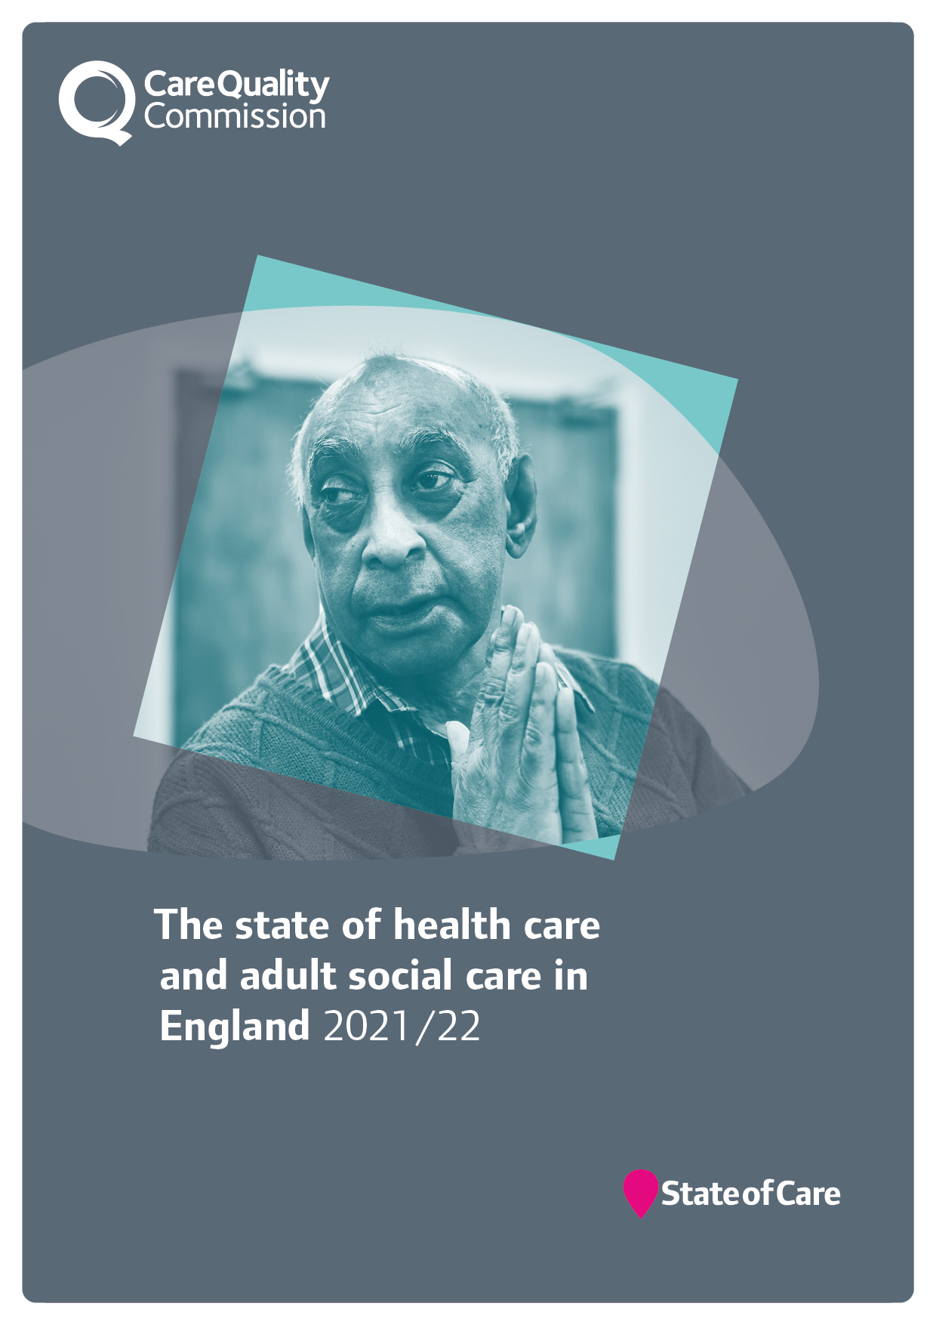
Our role and purpose
The Care Quality Commission is the independent regulator of health and adult social care in England.
We make sure health and social care services provide people with safe, effective, compassionate, high-quality care and we encourage care services to improve.

Slide 3
Changes to our regulatory approach
Multiple assessment frameworks
Single assessment framework
Ongoing monitoring and with inspections scheduled according to previous rating
Ongoing assessment of quality and risk
Evidence gathered during onsite inspection (single point in time)
Evidence gathered at multiple points in time (not just through inspection)
Judgements and ratings decisions made using ratings characteristics
Teams assign score to evidence
Narrative inspection report
Ratings updated, short narrative published
Notes:
This slide is animated. Each click of your mouse or clicker, should give you a new line.
We know that it’s helpful to see how our future model relates to what we’ve been doing over the last 8+ years – here are some examples of what could feel different. On the left hand side of the screen you have how things are now, on the right is how it will work in future.
Our assessment framework
Now: we have three different frameworks (registration, health, ASC) covering our five key questions – they are duplicative (eg across the KLOEs) and are not fully relevant to health and care today.
Future: we’ll have a single assessment framework that cover all sectors, services, levels – this will simplify things greatly for providers and ourselves. What we look at won’t change significantly, but how we do it will feel very different.
Our assessment approach
Now: We have separate ‘monitor’, ‘inspect’ and ‘rate’ steps and we inspect at a set point in time, based mainly on the previous rating.
Future: We’re moving away from separate ‘monitor’, ‘inspect’ and ‘rate’ steps in our model and will instead use the information we receive, collect and analyse to assess providers more frequently, without being tied to set dates.
The information will come from multiple sources and gathered in a variety of ways. Our operational colleagues will have a key role in increasing the flow of information into the regulatory platform. This will be a dynamic process and presented to colleagues in a clear and accessible dashboard through the regulatory platform, helping us make better decisions.
This does also not mean fewer inspections for high risk services. Our colleagues will have a greater ability to identify the best course of action - this could be that they work in the local area to find out more information, or schedule a site visit to the service to observe care or speak to staff. It is important to note that in settings where there is a higher likelihood of a closed culture developing we would prioritise these services for site visits for these services. More flexibility and improved prioritisation across all services means we can focus our activity where it’s most needed.
Categorising and scoring evidence
Now: make judgements against the ratings characteristics and the key question ratings aggregate to give us an overall rating.
Future: We want to be more consistent and transparent in our approach and how we make judgments on quality. We want our ratings to better reflect the care people are receiving and be clearer about where a provider or service sits within a rating. To address this, we’re developing a way to categorise and score evidence as part of our assessments.
Reporting and outputs from our assessments
Now: we publish long pdf reports that are not very accessible and take time for us to write and for the public to read.
Future: We are moving away from long pdf reports – we know that they don’t work for the public or for providers. They are inaccessible and not fit for what people expect from us. We also know that they take up much of our inspectors valuable time to produce them in the first place.
We will be able to give a much more up to date view of quality. We can’t do that unless we streamline the processes around publishing reports. We want to make them shorter, and more tailored to the audiences that use and read them. People will be able to make better choices about their care as information will be presented more clearly and detailed benchmarking information to help the provider improve will use the provider portal, rather than be published online

Slide 4
Mitigation
Key Question:
Well-Led
Quality Statement:
Environmental Sustainability
Adaptation
Key Questions:
Safe and Well-Led
Quality Statements:
Safe environments
Governance, management and sustainability
Notes:
How
SAF
ICS

Slide 5
Our single assessment framework
Underpinned by best practice standards and guidance
Specific
evidence and quality indicators
Five key questions
Our framework will assess providers, local authorities and integrated care systems with a consistent set of key themes ​
Giving us an up-to-date view of quality​
Helping us better identify trends and patterns across areas
Evidence categories​
Quality statements
https://www.cqc.org.uk/page/single-assessment-framework
Notes:
Our ratings and key questions will stay central to our approach, but we’re replacing our existing key lines of enquiry and prompts with ‘quality statements’. These will reduce the duplication that’s in our current assessment frameworks and will allow us to focus on key topic areas under each key question. We call the quality statements ‘we statements’ as they’re written from a provider, local authority or ICS perspective to help them understand what we expect of them.
Our new assessment approach means we’re moving away from separate ‘monitor’, ‘inspect’ and ‘rate’ steps. Instead, we will use information from a range of sources to assess providers in a more flexible way, without being driven by a previous rating. This is key to us achieving our strategic ambition of providing an up-to-date view of quality.
5 key questions
The framework is built on our five key questions and well known ratings system and will be what we use to set out our view of quality and make judgements.
We have drawn on work done previously by Think Local Act Personal (TLAP), National Voices and the Coalition for Collaborative Care on Making it Real. They co-produced a personalised care and support framework that can be used by people who work in adult social care, health, housing and people who use services. Importantly, this sets out what good and outstanding person-centred care looks like and what people should expect from providers, commissioners and system leaders.
We want to use ‘I statements’ as the starting point for our assessment framework, taking the important first step towards truly regulating through the eyes of the public. As the statements encapsulate the views and expectations of real people, we feel that giving them a prominent place in our single assessment framework helps to focus the whole health and social care system on people at a very human and relatable level.
Quality statements
We are introducing a set of ‘quality statements’, pitched at the level of ‘good’ and linked to the regulations that will help us make our judgments about the quality of care. They will replace our current Key Lines of Enquiry (KLOEs) and prompts and be expressed as ‘we statements’ helping to make things clearer for providers about our expectations on them, while reducing the duplication that currently exists across our KLOEs.
We will use this set of statements in our assessments of all sectors and service types and at all levels, using them to register services with a provisional rating of good through to our new work looking at local authorities and integrated care systems. This will be the basis for our single assessment framework.
Evidence
We want to be more consistent and transparent in our approach and how we make judgments on quality. To address this, we’re developing a way to categorise and score evidence as part of our assessments. The evidence ‘categories’ will bring more structure to our process for assessing quality. The six categories are:
Peoples experiences
Feedback from staff and leaders
Observations of care
Feedback from partners
Processes
Outcomes of care.
To enable us to be clearer with providers and the public about how we use the information we have about care in a service or local area we will set out which of those evidence categories we will look at for each service type and at each level – including at registration.
Specific evidence and quality indicators
Our operational colleagues will gather evidence specific to their area of expertise in order to make a judgment.
This will vary depending on the service type – for example, the evidence we can collect in GP practices, will be different to what we’ll have available to us in an assessment of a home care service. They will also depend on the level at which we’re assessing – for example, the evidence we have available to us when a service is registering with us for the first time will be different than when a service has been operating for a while.
By structuring our assessment framework in this way, we can ensure that our assessment framework has the flexibility we need.
In many ways this will all be data and evidence already familiar to providers and to our inspectors. By bringing in the six categories alongside a way of scoring evidence, we aim to able to bring a more structured and consistent framework for assessing quality.
Moving away from monitor inspect to a new flexible approach so inpspectins will not set freq and have more ongign assessment of quality in response to risk and give a more up to date view of quality
This is our single assessment framework for our regulation of providers, local authorities and systems. It focus on what matters to people who use health and social care services and their families. It is the key to us providing an up-to-date and accurate view of quality.
So why do we need a single assessment framework?
There are three main reasons why we need to change:
We need to make things simpler so we can focus on what really matters to people.
We need to better reflect how care is actually delivered by different types of service as well as across a local area.
We need one framework that connects our registration activity to our assessments of quality.
This will ultimately give us a clear and up to date view of quality and help us to better identify trends and patterns across the various areas.
Our new assessment approach means we’re moving away from separate ‘monitor’, ‘inspect’ and ‘rate’ steps. Instead, we will use information from a range of sources to assess providers in a more flexible way, without being driven by a previous rating. This is key to us achieving our strategic ambition of providing an up-to-date view of quality.

Slide 6
Quality Statement (Well-led key question)
Environmental sustainability – sustainable development
We understand any negative impact of our activities on the environment, and we strive to make a positive contribution in reducing it and support people to do the same.
Notes:
What can you do as Clinicians or Medical Directors?
More than just estates
Innovation – adoption of new care pathways and methods of care
GIRFT and low value interventions and medicine use
Adapting and changing pathways – especially outpatients

Slide 7
Quality Statement (Well-led key question)
People’s Experiences
Observation
Outcomes
Processes
Feedback from staff and leaders
Feedback from partners
We have defined six evidence categories
Not all categories will be required for all quality statements
Evidence categories will be assigned a score on a four point scale for each quality statement (where they apply)
Notes:
By law, care providers have to display the ratings CQC give them. They must also show their ratings on their website, if they have one
The evidence required to make an assessment against each topic area and related Quality Statements will be specified
This will be structured based on six evidence types. They signal the types of evidence we use to understand the quality of care being delivered against each Quality Statement. These are based what our existing KLOEs seek to uncover;
What is people’s experience?
What do staff and leaders tell us?
What have we heard from our partners?
What have we observed?
What do we know from the organisation’s process – their systems, policies and records?
What can we learn from outcomes and performance data?
The required evidence will differ according to:
Registration and ongoing quality assessment
Service model
Level of assessment (service, provider, local authorities or Integrated Care Systems (ICS)
The required evidence will be tailored to each service type to ensure that a meaningful assessment is made, and at service type level, we will change the lower level of evidence requirements more frequently than the Quality Statements, in line with the most up to date best practice standards, guidance and academic research and where we have evidence that we may wish to move the quality bar.
Our system will link best practice standards and guidance to the topic areas and related Quality Statements​ in our digitally hosted assessment tools for all sectors

Slide 8
Quality Statement (Well-led key question)
Sub-topics
Staff awareness and education
Carbon reduction e.g., within travel and transport, medicines, and supply chain
Health promotion and prevention.
Estates and Facilities e.g., energy saving measures, lower carbon options and recycling.
Notes:
Environmental sustainability – sustainable development - Care Quality Commission (cqc.org.uk)
Environmental sustainability - Care Quality Commission (cqc.org.uk)

Slide 9
Quality Statement (Well-led key question)
Environmental sustainability – sustainable development
Currently “Live” in Trust Level Well Led Assessments/Inspections and ICB Assessments.
Will be rolled out to other sectors after 1 year.

Slide 10
Anticipatory
Organisational
.
Directive
Relational
How regulation can impact on providers performance
Informational
Stakeholder
.
Lateral
Systemic
* Impact of the Care Quality Commission on provider performance: Room for improvement? The Kings Fund 2018
Notes:
Anticipatory: Changes are made before the inspectors arrive.
Directive: Regulators tell providers to do things
Informational: Published information provokes action.
Lateral: Providers work with peers to learn and improve
Organisational : Organisations make changes beyond those directed
Relational : Ongoing relationships have an impact
Stakeholder: Stakeholders work with providers to bring change
Systemic: Aggregated findings provoke wider change
Lateral : Social Care

Slide 11
outcomes
High quality care,
Low environmental impact
Sustainable value
patients
populations
environmental
social
financial
impacts
The TRIPLE BOTTOM LINE
Mortimer F, Isherwood J, Wilkinson A, Vaux E. (2018) Sustainability in quality improvement: redefining value. Future Healthcare Journal. Vol.5(2):88-93
Notes:
Introduce this as :
How we have been approaching ES based on the sub topics and how we think impact can be made

Slide 12
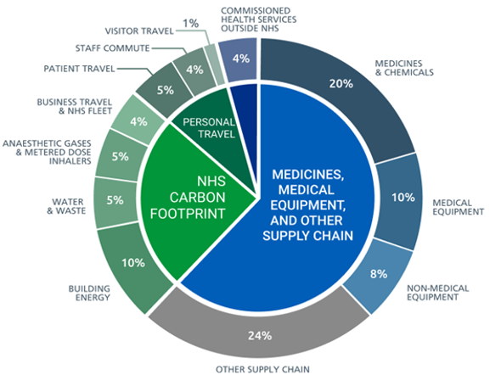
Emissions – Whole NHS
Medicines = 20%

Slide 13
Emissions - Primary Care
Prescribing footprint in Primary Care –
What happens in Secondary Care is highly influential to the long-term prescribing pattern in Primary Care.
Non-Clinical
39%
Pharmaceuticals and Chemicals
48%
MDIs
13%
Health care's response to climate change: a carbon footprint assessment of the NHS in England
Tennison, Imogen et al.
The Lancet Planetary Health, Volume 5, Issue 2, e84 - e92

Slide 14
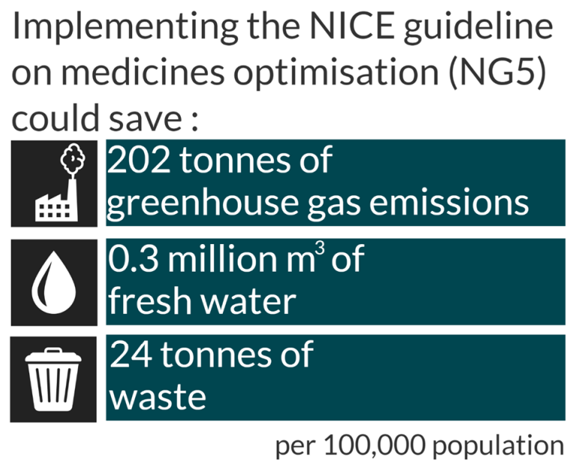
Medicines sustainability
Health inequalities
Patient health
GP workload
Financial burden
Protects future healthcare
Notes:
What is meds sustainability and why is it important- reducing NHS carbon footprint​
Health and social care services produce around 5% of all carbon dioxide in the UK and the largest proportion of this comes from medicines and equipment. Medicines account for 25% of the NHS’s total carbon emissions. (https://www.england.nhs.uk/greenernhs/a-net-zero-nhs/areas-of-focus). This includes all stages in medicines use for example production, choice, prescribing, and waste disposal, so this impacts every service that uses medicines. ​
​
Total for England 60,000 tons CO2
7000 tons of waste
1.8 m3 water

Slide 15
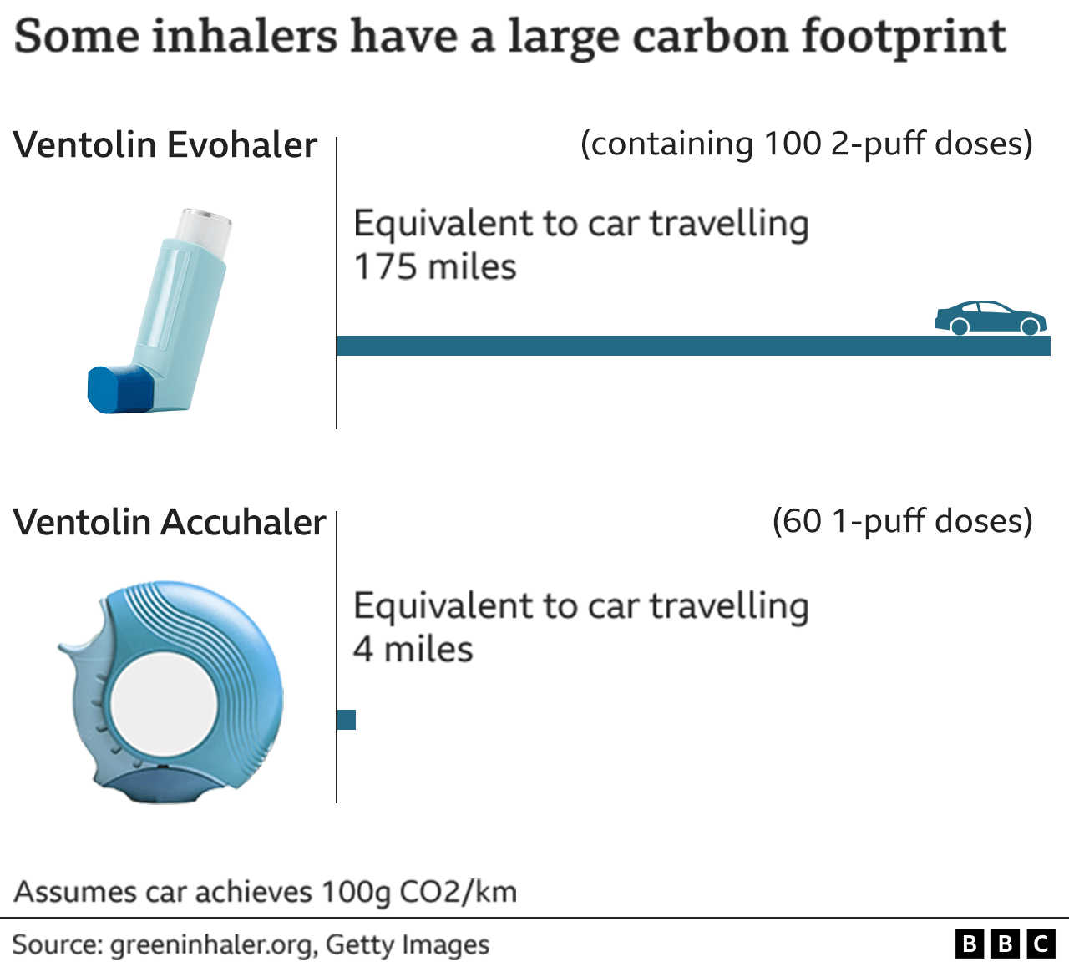
Medicines Optimisation: Inhalers
Inhaler technique
Patient choice
Optimum control
Patient adherence
Appropriate disposal
London to Sheffield
London to another bit of London
Notes:
Reviewing people’s treatment and switching to dry powder inhalers where appropriate optimises peoples care, ensuring they get the best from their medicines improving the control and management of their asthma whilst also reducing the carbon impact.

Slide 16
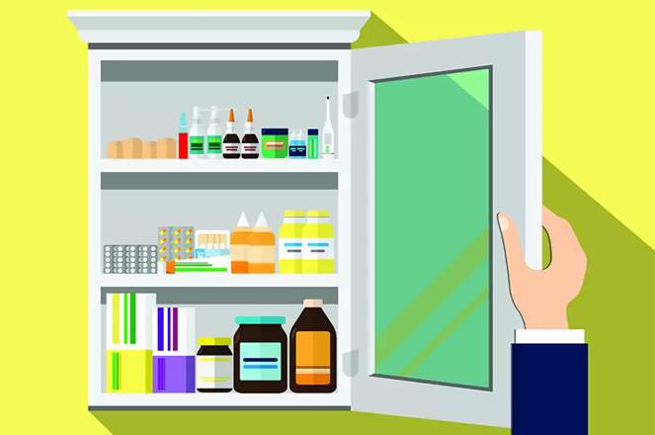
“Show me your meds please?”
£300m is wasted on medicines that are thrown away or stockpiled.
Notes:
We know that the medicines prescribed and dispensed for a patient are not always the medicines they are taking. A South Somerset pilot project has demonstrated why asking to see a patient’s medicines during a home visit can have a considerable impact on their health, including identifying many patients who were non-adherent, leading to significant quantities of medicines being wasted.
Triple bottom line
In the first three-month pilot, 40 patients were identified not adhering to their prescribed medication regime; this accounted for 1 in every 4 people assessed.
Overall, 1,049 individuals months were identified of unused prescription items and the total amount of wasted medication was valued at £10,866. It is estimated that every pound spent on pharmaceuticals generates greenhouse gas emissions of 0.1558kg CO2; therefore, these wasted medicines represents 1,693kg of avoidable CO2 emissions — the equivalent of a return flight from London to New York City.
During the pilot, 39 medicines were stopped, providing a predicted cost saving over the next 12 months of £3,529 and 549kg CO2 emissions prevented.

Slide 17
Polypharmacy and MURs

Slide 18
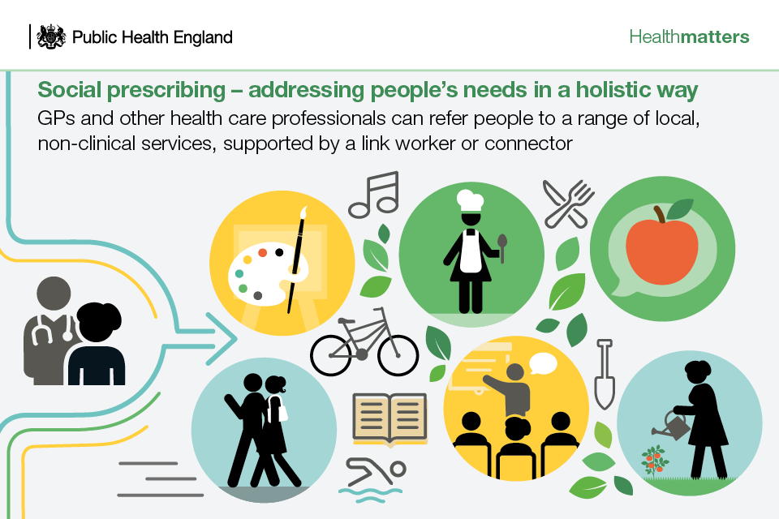
Social prescribing
Notes:
Use social prescribing to tackle medicines waste

Slide 19
Quality Statement (Well-led key question)
Decreasing waste in the delivery of clinical care
GIRFT/Choosing wisely and low value interventions and medicine use.
Adapting and changing pathways – especially remote and Digital
Right Patient, Right Appointment, Right support
Notes:
Other Waste includes
Going Paperless
Recycling
Single Plastics
Re-Use/single use – clinical instruments
Leaking gases (Staff Benefit)
Energy waste

Slide 20
Provider Bulletin
https://www.cqc.org.uk/news/newsletters-alerts/email-newsletters-cqc or Search: CQC bulletin
Publications
https://www.cqc.org.uk/publications
Social
@CQCProf @CQCProf
youtube.com/user/cqcdigitalcomms
facebook.com/CareQualityCommission
CQC is changing – YouTube playlist
https://youtube.com/playlist?list=PLEwLzOd_XW-IU-FCX2gvNu3OYG1aHn365
Digital platform
https://cqc.citizenlab.co/en-GB/ or Search: Citizenlab CQC
Podcasts
Wherever you listen to podcasts Search: CQC Connect
Blogs
https://medium.com/@CareQualityComm
or Search: Medium CQC
Notes:
CQC is changing playlist
This will have a playlist of all of the webinars that we have conducted in this period of time on the transformation
The last webinar, on the 2 August, will be here too

Slide 21
Over to you…
Any questions?

Slide 22
Dr Tim Ballard
National Clinical Advisor
General Practice, Online and Independent Healthcare
(Primary Medical Services) and Environmental Sustainability
tim.ballard@cqc.org.uk
www.cqc.org.uk
enquiries@cqc.org.uk
@CQCProf
youtube.com/user/cqcdigitalcomms
facebook.com/CareQualityCommission

