Slide 1
Overview of VCFSE / LSC SIS workshop learning, outputs and recommendations 12th September 2024
Joe Hannett, LSC VCFSE Alliance lead
Linda Vernon, Head of Digital Empowerment

Slide 2
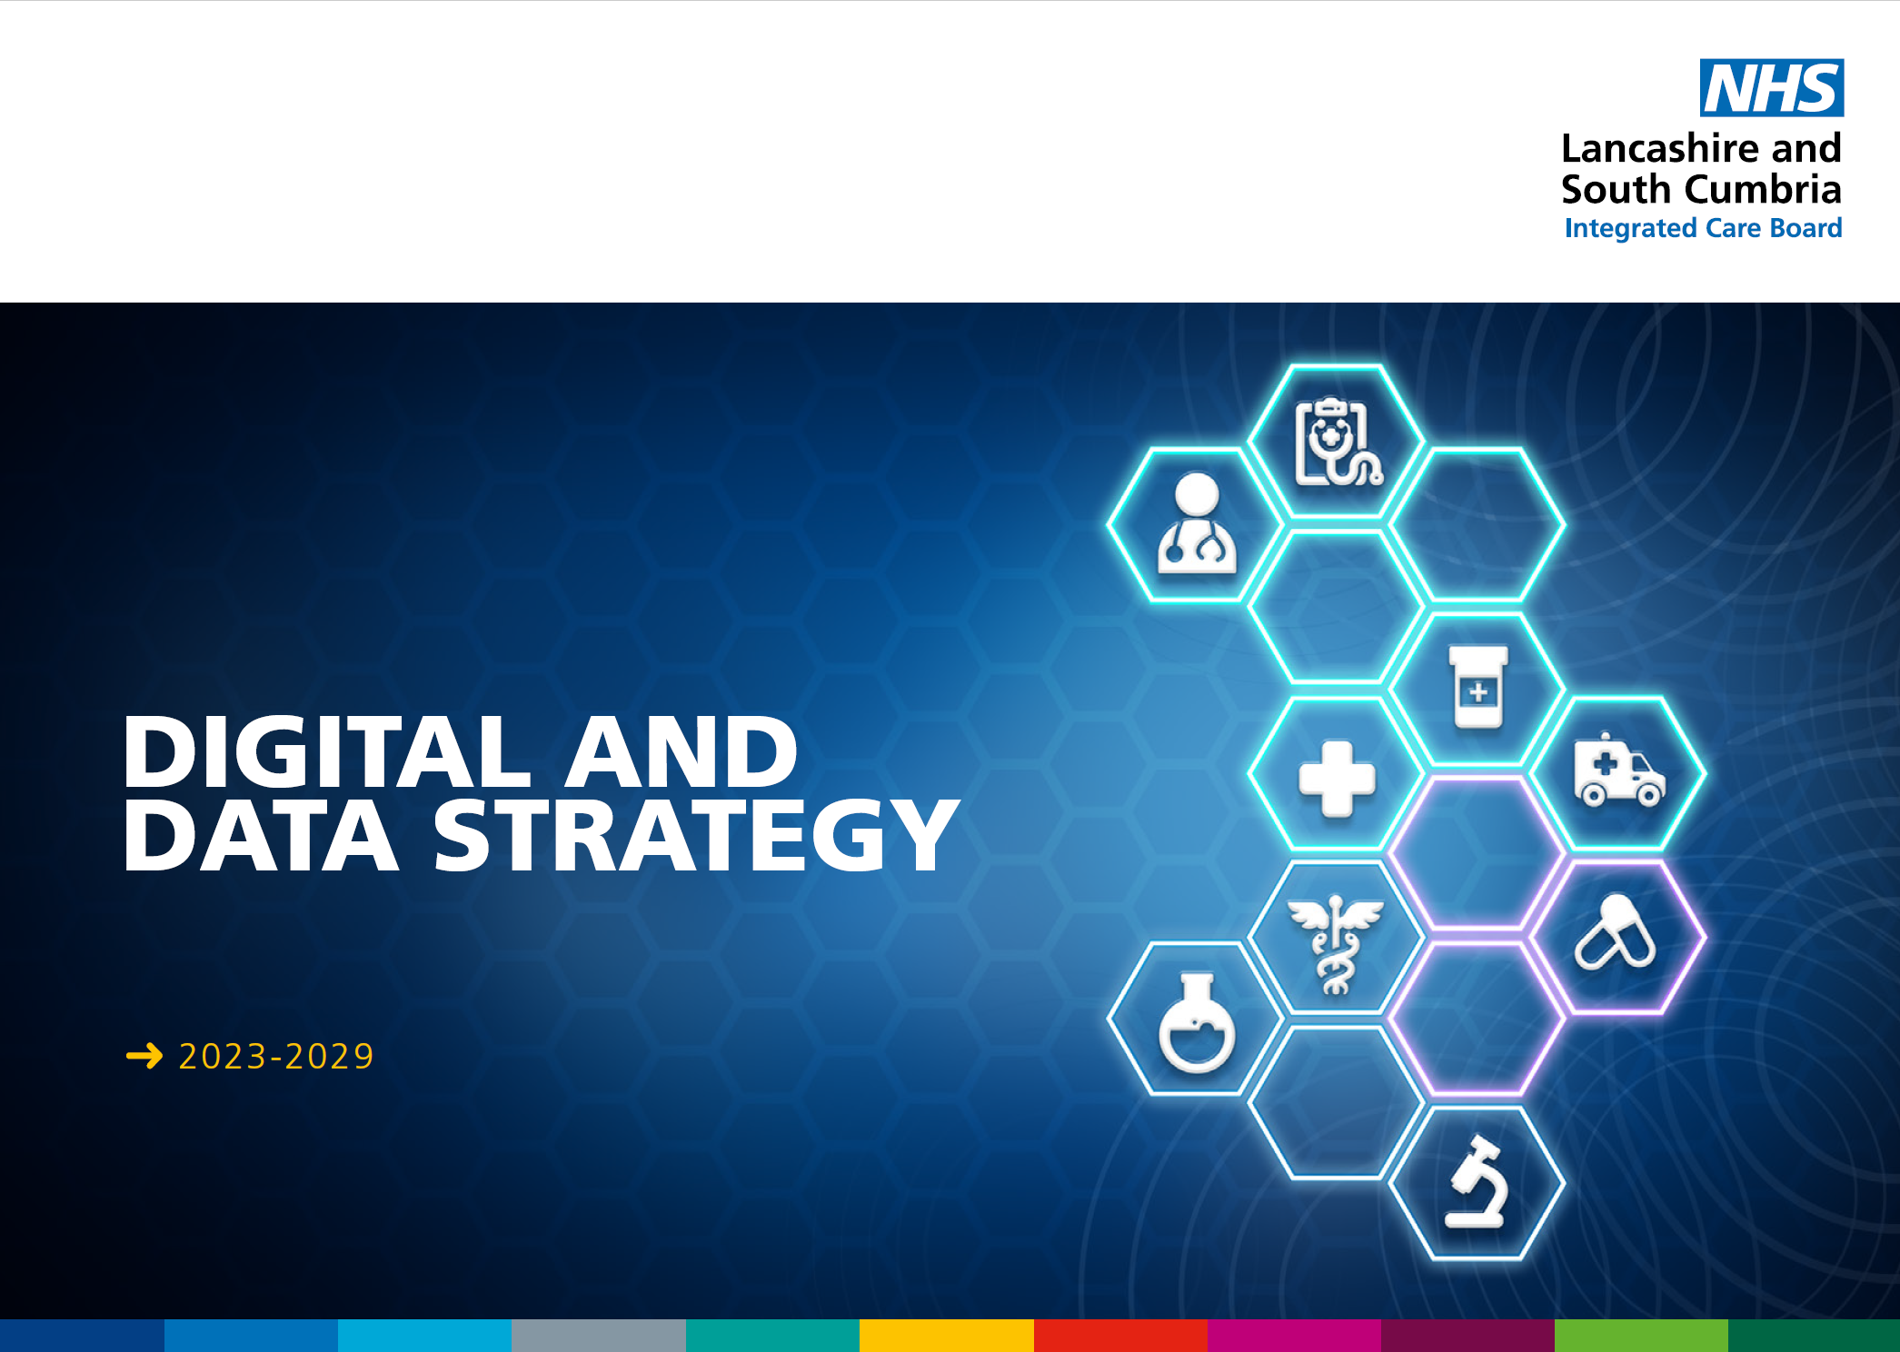
Context: Digital & Data Strategy 2024-2029

Slide 3
What we did … Breakouts
13:30 – 14:00 (30 mins) | Networking lunch | Lunch will be provided
14:00 – 14:10 (10 mins) | Welcome and scene setting | Asim Patel & Tracy Hopkins
14:10 – 14:20 (10 mins) | Ambitions for the day | William Lumb
14:20 – 15:00 (40 mins) | L&SC System Information Service Demonstration of Capabilities | Stewart Bond
15:00 – 15:15 (15 mins) | Breakout Session 1 | Linda Vernon/Joe Hannett
15:15 – 15:30 (15 mins) | Break
15:30 – 16:15 (45 mins) | Breakout Session 2 | Linda Vernon/Joe Hannett
16:15 – 16:25 (10 mins) | Next steps | William Lumb
16:25 – 16:30 (5 mins) | Close | William Lumb/Joe Hannett
What data types do you collect in your organisation?
How do you record this data and is it identifiable or anonymised?
What data sources do you use in your organisation?
What challenges do you face that you feel data could help solve?
What types of data would help you to address these challenges?
What benefits do you perceive could be realised (for our population, your organisation and other parts of the health & care ecosystem)?
Are there any barriers or hurdles we might need to overcome to work collaboratively on this?

Slide 4
Pre-workshop feelings …

Slide 5
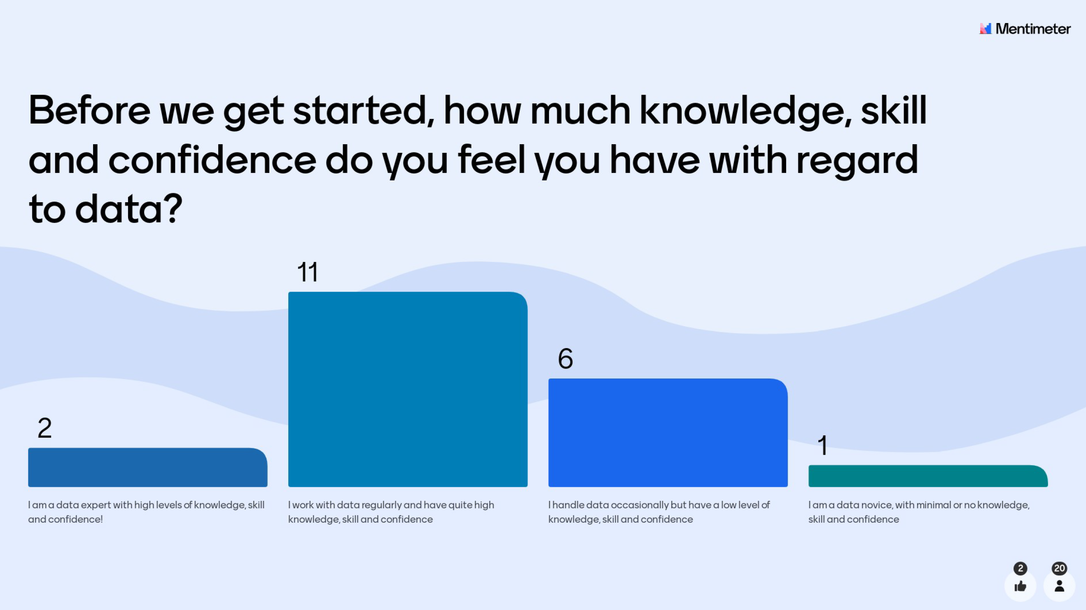
Pre-workshop KSC …

Slide 6
Insights gathered
Data collected | Other data used | Challenges | Benefits | Types of data
Detailed and thorough data on demographics, health conditions, income, medication, outcomes. | NHS referrals | engaging smaller VCFSE orgs | targeted resources / investment | The population / demographic health data Stewart showed would be useful. Also, school abscences / exclusions/ free school meals
Demographics, mental & physical health data, children & perinatal, money benefits & debt, employment history, drug and alcohol data, data from the criminal justice system - orders, criminal history | Public health data, office for national statistics, fingertips | currency of the data (particularly when the focus is on building the evidence base) | influencing commissioning and service design to be more person-centred | Tricky - this one is a 'I dont know what i don't know'. But the sort of deprivation / poor health which Stewart showed would be helpful
Demographics, personal, activity recording | Mainly ONS | technical challenge - collecting VCFSE held data | person-centred care delivery - holisitci support for individuals | Anything that would support investment in VCFSE services. I.e track reduced anti depressant use as a result of a social intervention
Demographic, health, social and lifestyle, some clinical, some highly clinical and confidential. Shared Care Record “read only” access (CGL). | We don't use as much outside data for analysis as we could. We tend to collect a lot of our own data and work with that. | time lapse - linking datasets | shifting the focus to prevention and more effective use of NHS resources | Understand profile and location of people not accessing services (are there addresses that have no contact with services apart from emergencies)?
demographics, group/activity attendance, volunteering, health conditions, wellbeing | All above | needs to be streamlined | Cost-benefit --> proof that services work for clients and funders, are needed, and money that can be saved by funding the sector | Impact of activity, signal in A&E numbers?
Lots of personal and sensitive data -from name and address to debt information from the client. We use health and wellbeing surveys and advice issue codes to categorise data |  | Trust! | data can help to highlight the role of the sector | - a way of capturing Health and wellbeing survey information - Eq5d to show client journey and improvements as a result of a VCSE intervention - social value data.

Slide 7
Insights gathered
Data collected | Other data used | Challenges | Benefits | Types of data
Usually just names and contact details |  | A perception that the ICB still does not treat the VCFSE as an equal / professional partner | access to data that enables orgs to provide holistic support | Know who else is working with an individual, potentially avoiding duplication.
Simply names and contact details |  | How often is this data refreshed? | enabling services and resources to be targeted more effectively | All services to measure the outcomes data - standardisation for all.
 |  | How accurate is this data (Miss / non coded interactions). | shifting the focus to person-centred (rather than condition0-specific) care
 |  | - smaller organisations might get missed so support from infrastructure VCFSE for support in sharing data. - need resource support for smaller VCFSE to support data sharing. may not have data peps | evidencing the effectiveness of interventions
 |  | Existing data sharing agreements barely work to get the data we need to deliver contracts | influencing services design
 |  | Standardised ways of sharing data - keep it simple. | moves us toward the sector being regarded as an wequal partner
 |  | Ability of smaller groups to eg gain an ISO accreditation if required. | "you value what you measure" - data is power!
 |  | One, 1hr discussion with EMIS can be a GIGANTIC cost. Unaffordable for anything other than a statutory body. | Tailored provision
 |  |  | - bid writing/funding bids, more targetted support - better health outcomes for communities - increased investment and evidence that VCFSE interventions need resourcing. - preventing poor health
 |  |  | Definite link with a ICS wide directory of services….( Referrals on clinical pathways)
 |  |  | Potential to reduce duplication, and promote collaboration
 |  |  | Possibility of targetng scarce VCFSE resources better. Huge opportunity to sharpen funding bids.

Slide 8
Summary of what we learned …
VCFSE organisations are impressed and excited by the possibilities the System Intelligence Service (SIS) offers, and its flexibility as demonstrated.
They saw numerous opportunities for consuming data, and began thinking about ways of contributing data, intelligence and insight to it.
That VCFSE data collection, security and research capabilities, and their use of this data to design, develop and evaluate services was more developed than expected.
Getting to a rich and useful ICS-wide data ecosystem will take time, with IG considerations recognised by all. All VCFSE organisations present were keen to remain involved, and a timeline needs to be produced to align expectations with feasibility.
In the short term a more coherent, and importantly zero or low cost, consumption use-case can be developed, with a medium to longer term view for a contribution use-case, as this will likely involve additional resources being secured.
VCFSE and ICB colleagues left the workshop feeling informed, involved, hopeful and optimistic.

Slide 9
WHAT next? …
Short term:
A single clear use case (consuming place and population-level data) was identified in supporting the VCFSE work in Blackpool and Blackburn with Darwen to improve UEC pathways. VCFSE leads are confident that accessing non-identifiable data can help them plan, target delivery and measure impact of interventions in this very specific piece of work. This will assist in learning what works well for the next stages.
Medium term:
Non-identifiable place and population level data made available to the wider VCFSE sector can support commissioning, planning and evaluation of impact of services more widely – particularly as they often are asked to report on KPIs that relate to data not readily available to them
Increasing the knowledge, skills and confidence of the sector in questioning, analysing and interpreting data (via collaborative learning opportunities with health and care partners – apprenticeships, demonstrations, case studies) will improve integrated care collaboration and reduce demand on analytical teams via self-service
Long term:
Access to patient identifiable data will require higher levels of information governance and security, and as such needs to be aligned with very defined use cases. While VCFSE leads see the added value of this in terms of more detailed analysis of impact of interventions, this isn’t a priority at this time, and will need a task & finish group, and approvals via relevant governance.

Slide 10
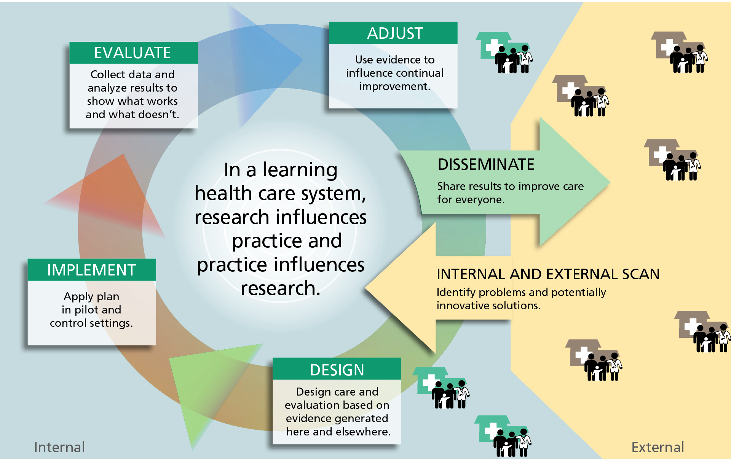
WHY this matters … learning health systems

Slide 11
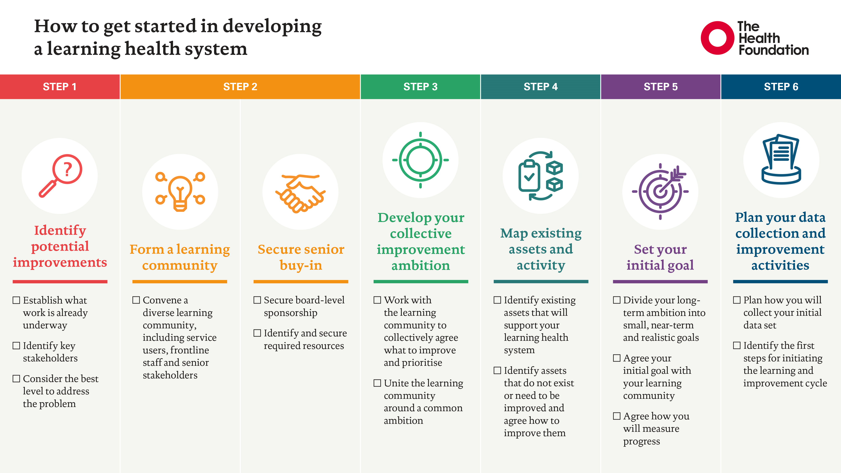
WHY this matters … learning health systems
Developing learning health systems in the UK: Priorities for action - The Health Foundation

Slide 12
WHY this matters …
Building our mutual partnership, trust and support. This work supports our partnership’s ambitions and will improve our assessment of our maturity against NHSE’s relevant QDT.
To explore the possibility of identifying areas to optimise or improve and increase partnership working to improve population health outcomes in LSC.
Utilising the capability of the SIS will support VCFSE organisations to target services and scarce VCFSE resources to the people and places where most effective.
Establish if the SIS can provide evidence for ICS partners on impact of VCFSE activities on population health and the financial health of the system, or support assertions of the same.
Provide evidence for VCFSE organisations preparing proposals to funding bodies.
Support organisational, sectoral, and wider research into the efficacy and impact of VCFSE services, their future development, and inter-dependencies.

Slide 13
HOW do we get there? …
Establish a small, joint working group to;
Develop a multi-year approach between the ICB and the VCFSE Alliance,
guide the development of the use-cases,
manage the relationship between the Alliance and the ICB in this context.
Focus on implementing this generic use-case for LSC VCFSE organisations to consume system and place non-patient-identifiable data and intelligence from the LSC SIS for agreed purposes (as per slide 8) with the agreement(s) subject to a review process TBD.
Where feasible enable access to the SIS for those present at the workshop to non-patient identifiable data to explore the system’s potential.
Create a capability for LSC active VCFSE domains to have access to SIS mediated by the LSC VCFSE Alliance and the ICB’s Data team if deemed prudent by either party, with a presumption of approval.
Work with system colleagues to develop data self-service and specialist analytical capabilities and expertise, to ensure as far as possible accurate use of this powerful tool, through the ICS apprenticeship levy fund and the available paths to increased data literacy.
In the medium to long term build on the experience gained from the consumption scenario to explore the potential and required resources to enable a contribution use case to be developed.
If access to patient identifiable data is deemed necessary by a VCFSE partner, this may be negotiated bi-laterally with the ICB as part of contract/grant negotiations or another forum TBD.

Slide 14
Anticipated outcomes:
Increased trust and partnership working between the ICB and the VCFSE Alliance, and wider VCFSE.
Improved system, place and organisational resource allocation and decision-making capabilities.
Richer, more nuanced data, intelligence and insight about our population’s health.
Improved recognition and increased activity to address complexity and intersectionality*.
Improved understanding of, and ability to act on, the wider determinants of health.
Increased resources flowing into the VCFSE year on year as evidence accumulates.
Improved ability to use VCFSE data in research into Health Inequalities and other areas.
Increased system data analyst capacity and capability**.
* the interconnected nature of social categorisations such as race, class, and gender as they apply to a given individual or group, regarded as creating overlapping and interdependent systems of discrimination or disadvantage.
**dependant on sufficient take-up of opportunities available through the Apprenticeship programme.

Slide 15
Discussion points:
Language matters: agreed consensus on what publishing and consuming means/synonyms? Define a “use case”
Drivers for this work: all opportunities/benefits articulated above – align with recovery & transformation and priority workstreams
Barriers including IG (only for identifiable data?) - Does access to anonymised, population level data require ‘approval’ or ‘sign off’ – if so, by whom/what governance structure?
Assumptions … ?

Slide 16
Web lancashireandsouthcumbria.icb.nhs.uk | Facebook @LSCICB | Twitter @LSCICB

